Slide 1
Star Wars vs star trek
Which Franchise is better? A Data Analytics View

Slide 2
Team # 2
Sean Carraher
Daniel Evans
Patricia Johsz
Karl Suaco

Slide 3
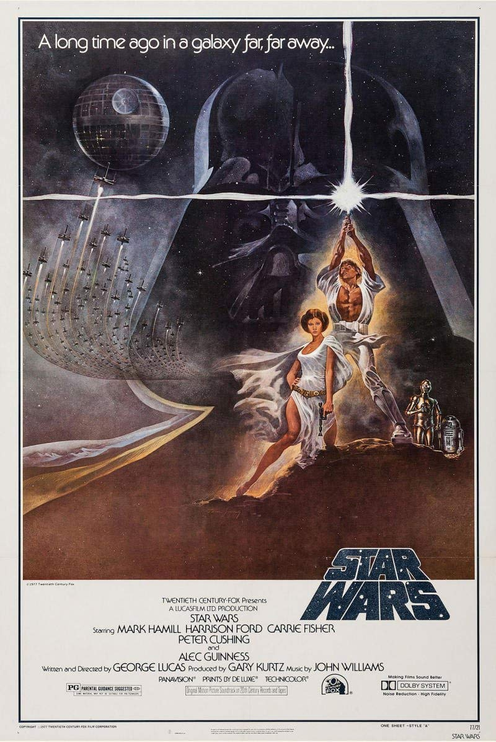

Which is better? Star wars Or Star trek?
Star Trek and Star Wars are both massive movie franchises each with their own devoted fan base.
Both franchises present alternate scenarios of space adventure.
Using Data Analytics We will attempt to answer the great debate on which franchise is better.

Slide 4
Data Analytics Approach
financial comparison
Budget / gross earnings summary
Social Media Comparison
Use google trends (limited to 2004 and beyond)
interest over time
Interest by state
Sentiment Analysis using Twitter data
Sentiment analysis using critic reviews

Slide 5
Star Wars Movie Titles
May 25, 1977 | Star Wars Ep. IV: A New Hope(Star Wars)
May 20, 1980 | Star Wars Ep. V: The Empire Strikes Back
May 25, 1983 | Star Wars Ep. VI: Return of the Jedi
May 19, 1999 | Star Wars Ep. I: The Phantom Menace
May 16, 2002 | Star Wars Ep. II: Attack of the Clones
May 19, 2005 | Star Wars Ep. III: Revenge of the Sith
December 16, 2015 | Star Wars Ep. VII: The Force Awakens
December 14, 2016 | Rogue One: A Star Wars Story(Star Wars Rogue One)
December 13, 2017 | Star Wars Ep. VIII: The Last Jedi
May 23, 2018 | Solo: A Star Wars Story

Slide 6
Star Trek Movie Titles
December 7, 1979 | Star Trek: The Motion Picture
June 4, 1982 | Star Trek II: The Wrath of Khan
June 1, 1984 | Star Trek III: The Search for Spock
November 26, 1986 | Star Trek IV: The Voyage Home
June 9, 1989 | Star Trek V: The Final Frontier
December 6, 1991 | Star Trek VI: The Undiscovered Country
November 18, 1994 | Star Trek: Generations
November 22, 1996 | Star Trek: First Contact
December 11, 1998 | Star Trek: Insurrection
December 13, 2002 | Star Trek: Nemesis
May 8, 2009 | Star Trek
May 16, 2013 | Star Trek Into Darkness
July 21, 2016 | Star Trek Beyond

Slide 7



Data Sources
IMDB .csv File
Twitter API
Rotten Tomatoes csv
financial information
Social Media Likes
Actor Likes
User comment extraction
vader analysis
Critic Review Extraction
Vader Analysis

Slide 8


Data Sources
The Numbers Website
Google Trends
financial information
Trend data From the Site

Slide 9
Analytical Approach
Gather the financial information compare based on time frame with adjustment
Only compare movies not TV
Geographic location
Use google trends
Gather tweets from day of last movie release

Slide 10
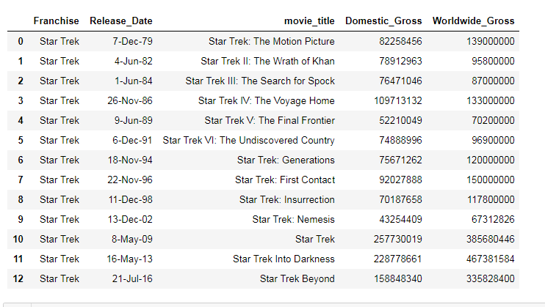
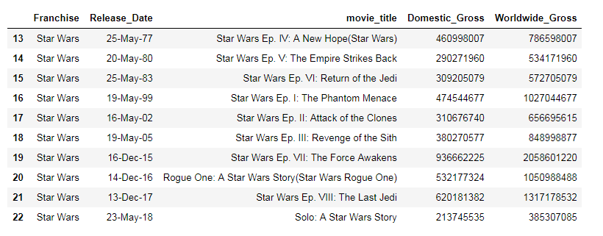
Financial
We compared World Wide Gross to Domestic Gross for both Groupings.
Star Wars: $9,238,289,540
Star Trek: $4,528,733,506
Star Wars won this by a Landslide!

Slide 11
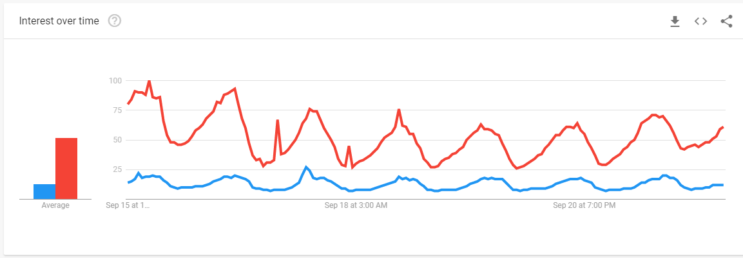
Google Trend
Using the website we compared
Star tRek and Star Wars
from 2004 to the Present

Slide 12
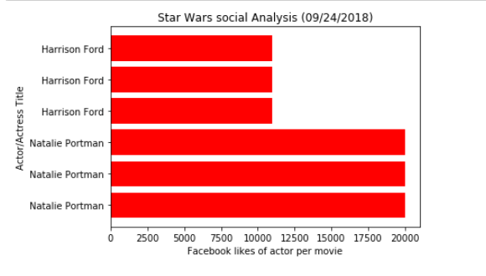
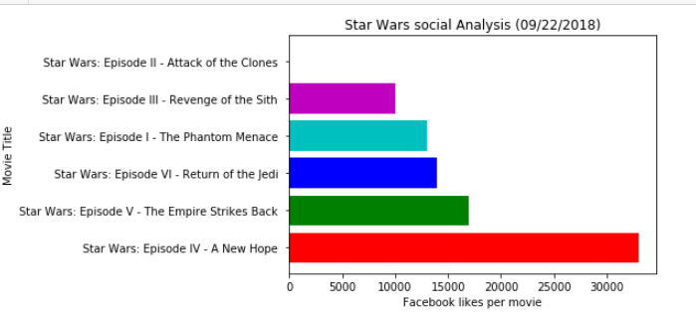
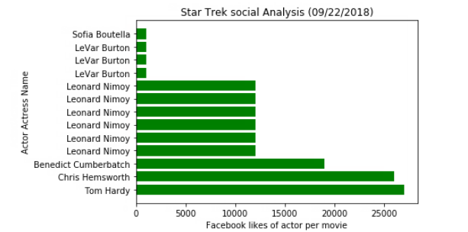
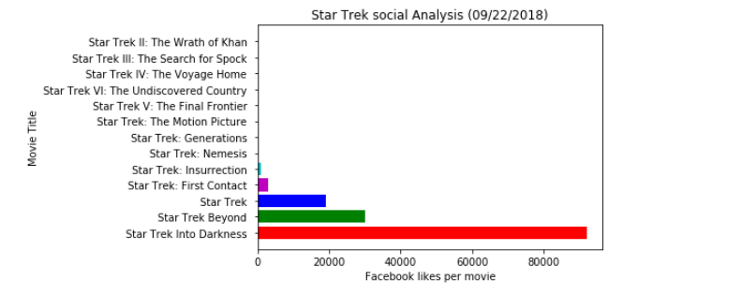
Social Media
Review Facebook likes for both actors and movies using the IMDB data.
Using this data source we found that Star Trek Fans were more socially active in support of their Franchise.
Conclusion:
Star Trek Wins!

Slide 13
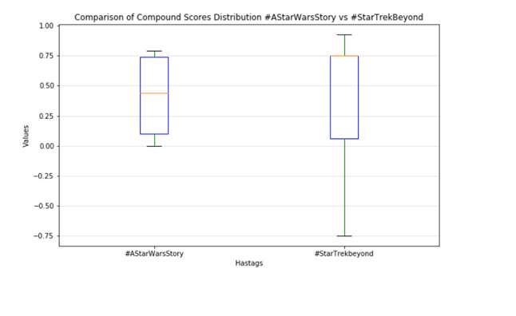
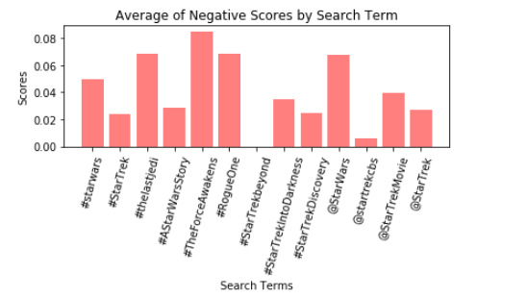
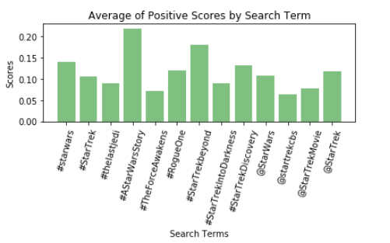
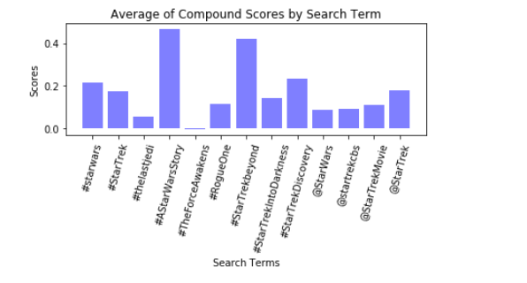
Twitter (Vader) analysis
The project reviewed Twitter data using Trending hash Tags and @USER data points.
The most recent movies had the best data resulting in better compound scores.
Conclusion: There can be Bias due to the release schedule. Over Time the scores will experience a lot of flux. Based on the results Star Trek Wins!

Slide 14
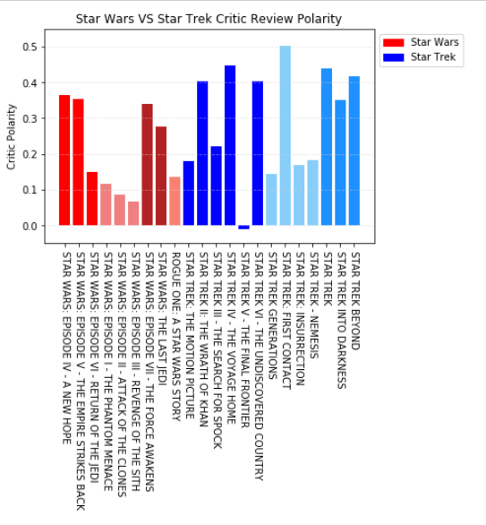
Critics Review
Using Rotten Tomatoes data we gathered critic reviews only. A Vader Analysis was completed for each review.
Overall Star Trek had a higher Polarity score in comparison of Star Wars. Although Star Trek experienced the lowest Polarity Score.
Conclusion: Critics liked Star Trek more,
Star Trek Wins!

Slide 15
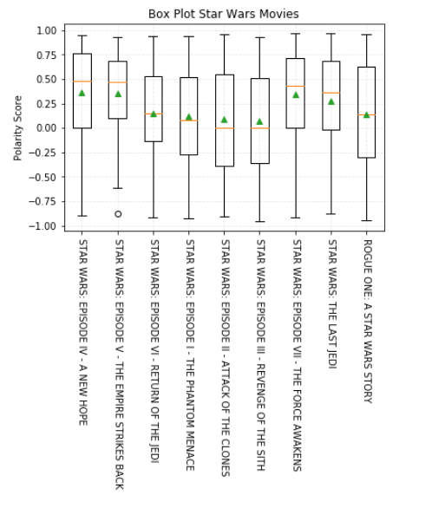
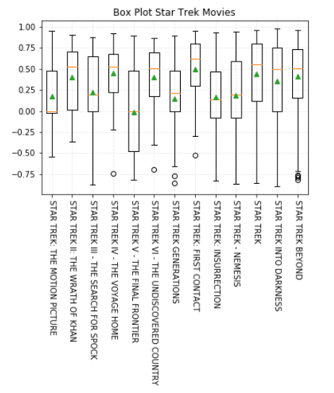

Slide 16
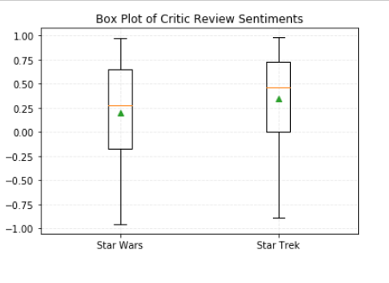
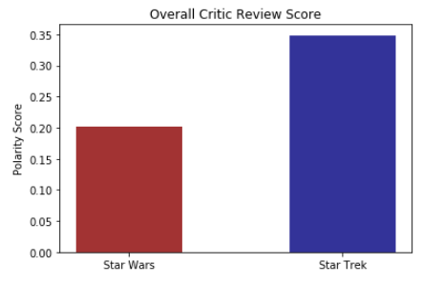

Slide 17

Conclusion
The winner is

